Slide 1


011 Coursework Guidelines- 2025-26
Dr Andre Samuel
andre.samuel@sam.edu.tt
http://samuellearning.org/scm.html

Slide 2
Requirements for Coursework

Slide 3
Aim
Develop a written consultancy report that provides:
  to address the company's operational issues and provide clear recommendations for enhancement.
  to define a suitable supply chain strategy for GreenCycle Mobility

Slide 4
Scenario Analysis (30%)
Use either the Porter Value Chain model or the SCOR model to analyse the situation.
Describe the current situation with the given case study, what are their current capabilities for supply chain management, and detail the opportunities for future growth of the company (Perform a SWOT then TWOS and report your TWOS analysis).

Slide 5
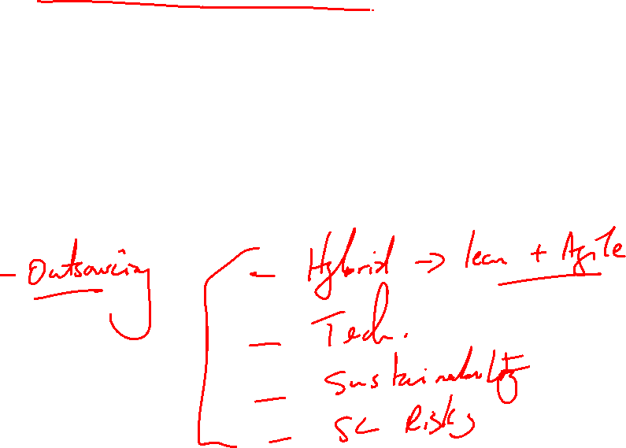
Supply Chain Strategies (30%)
Define how the case study organisation could establish a global supply chain, making reference to one supply chain theory such as Porter’s value chain, SCOR model, etc. and the impact on the company structure. The strategies could include references to the following:

Slide 6
Address these items in your Report:
a) Global supply chain operations, i.e., manufacturing, suppliers, engineering centre.
b)Advantages and disadvantages of outsourcing key sections of the supply chain.
c) Identify key supply chain risks and how these risks can be managed.
d) Benefits and disadvantages of Agile vs. Lean vs. Hybrid supply chain strategies.
e) Impact of future technologies in sharing information throughout the supply chain.
f) Impact on future eWaste regulations and reverse supply chains.

Slide 7
Conclusion and recommendations (30%)
Provide a clear set of recommendations defining your ideas how to establish a supply chain, based off your academic research

Slide 8
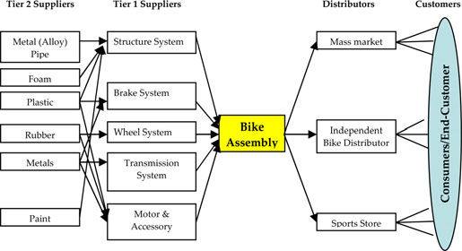
Bicycle supply chain structure
Chiu and Kremer 2014

Slide 9
Useful info
https://www.technavio.com/report/e-bike-market-industry-analysis
https://mobilityforesights.com/product/e-bike-market

Slide 10
Pon.Bike End-to-End Supply Chain with Locations
Supply Chain Stage | Key Operations | Main Locations (examples)
1. Corporate Strategy & Portfolio Control | Brand portfolio management (Gazelle, Kalkhoff, Urban Arrow, Cannondale, etc.); capital allocation; supply-chain coordination | Netherlands (HQ)
2. Product Design & Engineering | Bike architecture, frame geometry, e-drive integration, safety & compliance design | Netherlands; Germany; USA (brand-specific design centres)
3. Component Sourcing | Procurement of motors (e.g. Bosch), batteries, drivetrains, brakes, electronics | EU (Germany), East Asia (China, Taiwan), global Tier-1 suppliers
4. Frame & Sub-assembly Manufacturing | Frame fabrication and sub-assembly (predominantly outsourced OEM/ODM) | Taiwan; China; Southeast Asia (supplier cluster regions)
5. Final Assembly (Critical Control Point) | Final bike assembly, quality control, testing, certification, packaging | Dieren (Netherlands – Gazelle); Almelo (Netherlands – Cannondale); Amsterdam (Netherlands – Urban Arrow); Lithuania (Kėdainiai); USA (Santa Cruz); Brazil (Manaus)
6. Distribution & Logistics | Warehousing, dealer allocation, export logistics, regional fulfilment | Europe-wide DCs; North America; Latin America
7. Retail & After-Sales Network | Authorised dealers, service networks, warranty handling, spare parts | EU, UK, USA, Latin America
8. End-of-Life & Sustainability (Emerging) | Battery recycling coordination, circular design initiatives | EU-focused (regulatory-driven)

Slide 11
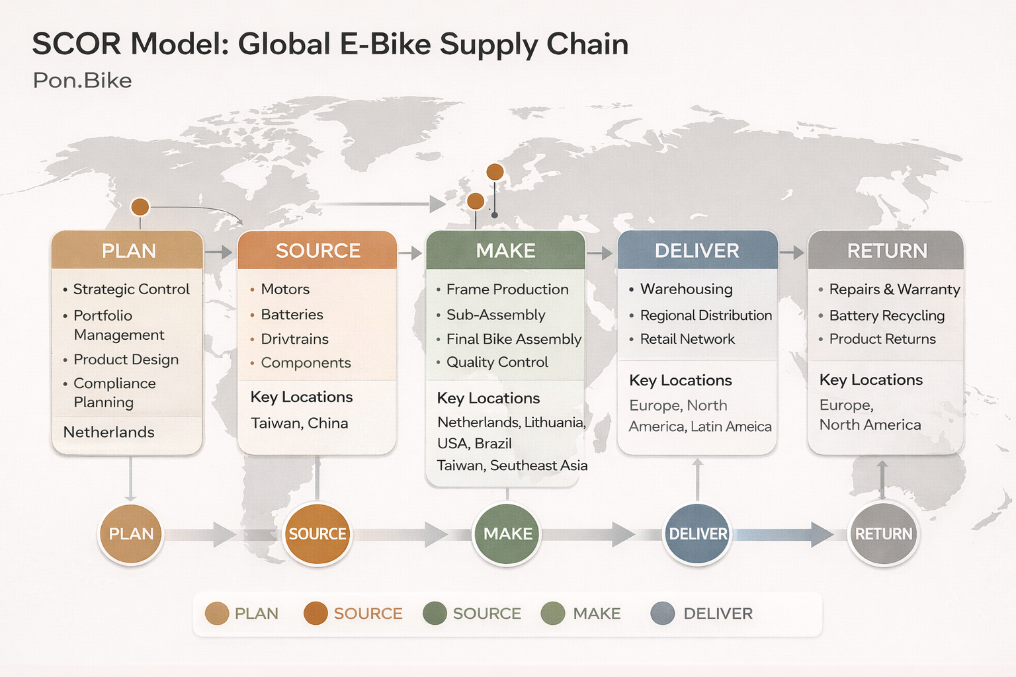
Pon Bike Global Supply Chain

Slide 12
Report Structure and Content

Slide 13
Report Format
Title Page
Executive Summary
Table of Contents
Body- section 1.0 to 8.0 (see below)
Reference List
Appendices (at your discretion)

Slide 14
Executive Summary
Provide a concise overview of the entire report.
Summarize the key points highlighting:
  The main issues GreenCycle Mobility currently faces
  Your recommended strategies.
This should briefly mention the primary findings, conclusions, and proposed solutions to give the reader a clear picture of the report in about 150–200 words.

Slide 15
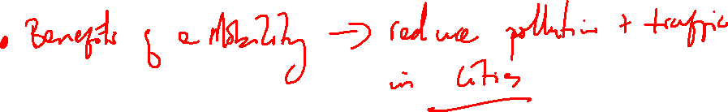
1.0 Introduction
Discuss the importance of Supply Chain Management
  Define supply chain
Brief background into the Electric bicycle and e-scooter Industry Supply Chain
  Industry Statistics (market size, major players etc)

Slide 16
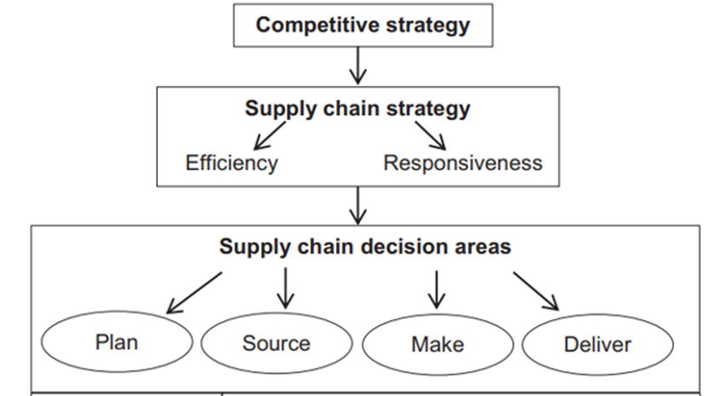
Give purpose of the report i.e.
  Analyse current scenario, capabilities and opportunities
  Develop a supply chain strategy for GreenCycle Mobility
State the key models and analytical tools that will be used to develop the SC strategy
  e.g. Porter’s Competitive Strategies, SCOR model, Competitor analysis, capability analysis, SWOT
Strategic SC Framework
Adapted from Santos et al (2021)

Slide 17
2.0 Scenario Analysis
Discuss the purpose of the section i.e.
  Objective: Analyse GreenCycle Mobility current supply chain situation and identify areas for improvement.
  Model Choice:
    Use either the Porter Value Chain model or the SCOR model to analyse the situation
    Perform a SWOT then TOWS and report your TOWS analysis

Slide 18
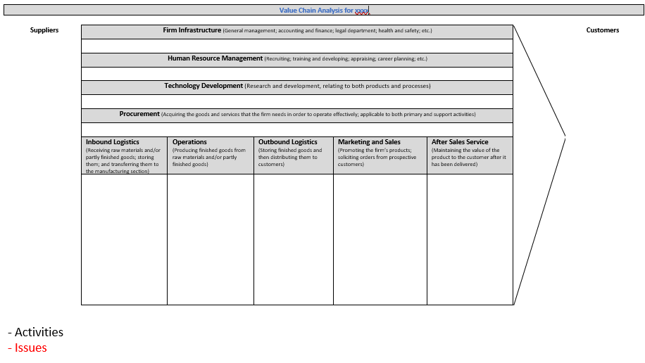
2.1 GreenCycle Mobility Current Situation
Give an overview of GreenCycle Mobility current Value Chain
  Who are their suppliers
  What are their operations- manufacturing, design
  Who are their customers
  Etc.
Include Value Chain Diagram
  Use template, Use case study
  Include issues in Red font for each activity
Write up findings

Slide 19
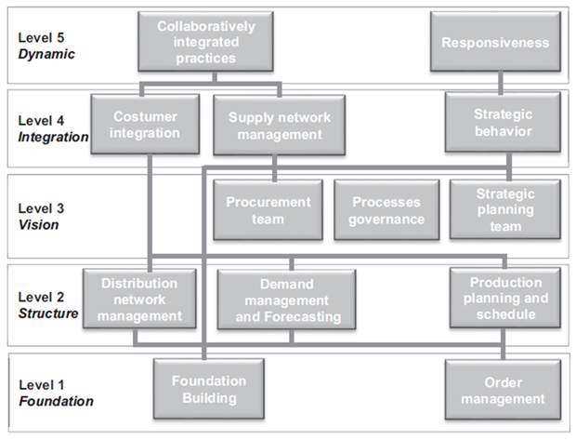
2.2 GreenCycle Mobility Capabilities
Using the SCPM3 (Oliveira et al. 2011) Maturity Stages.
Identifying GreenCycle Mobility ’s Capability Gaps
  Use the capabilities from the SCPM3
  Based on the details from case study, rate the capabilities using score 1-5
  Evaluate Current State
  Identify Gap
Therefore, assess overall SC Maturity Level
Write up findings
SCPM3 (Oliveira et al. 2011)
Capability | Current State (Score 1-5) 1- Low, 5- High Capability | Gaps

Slide 20
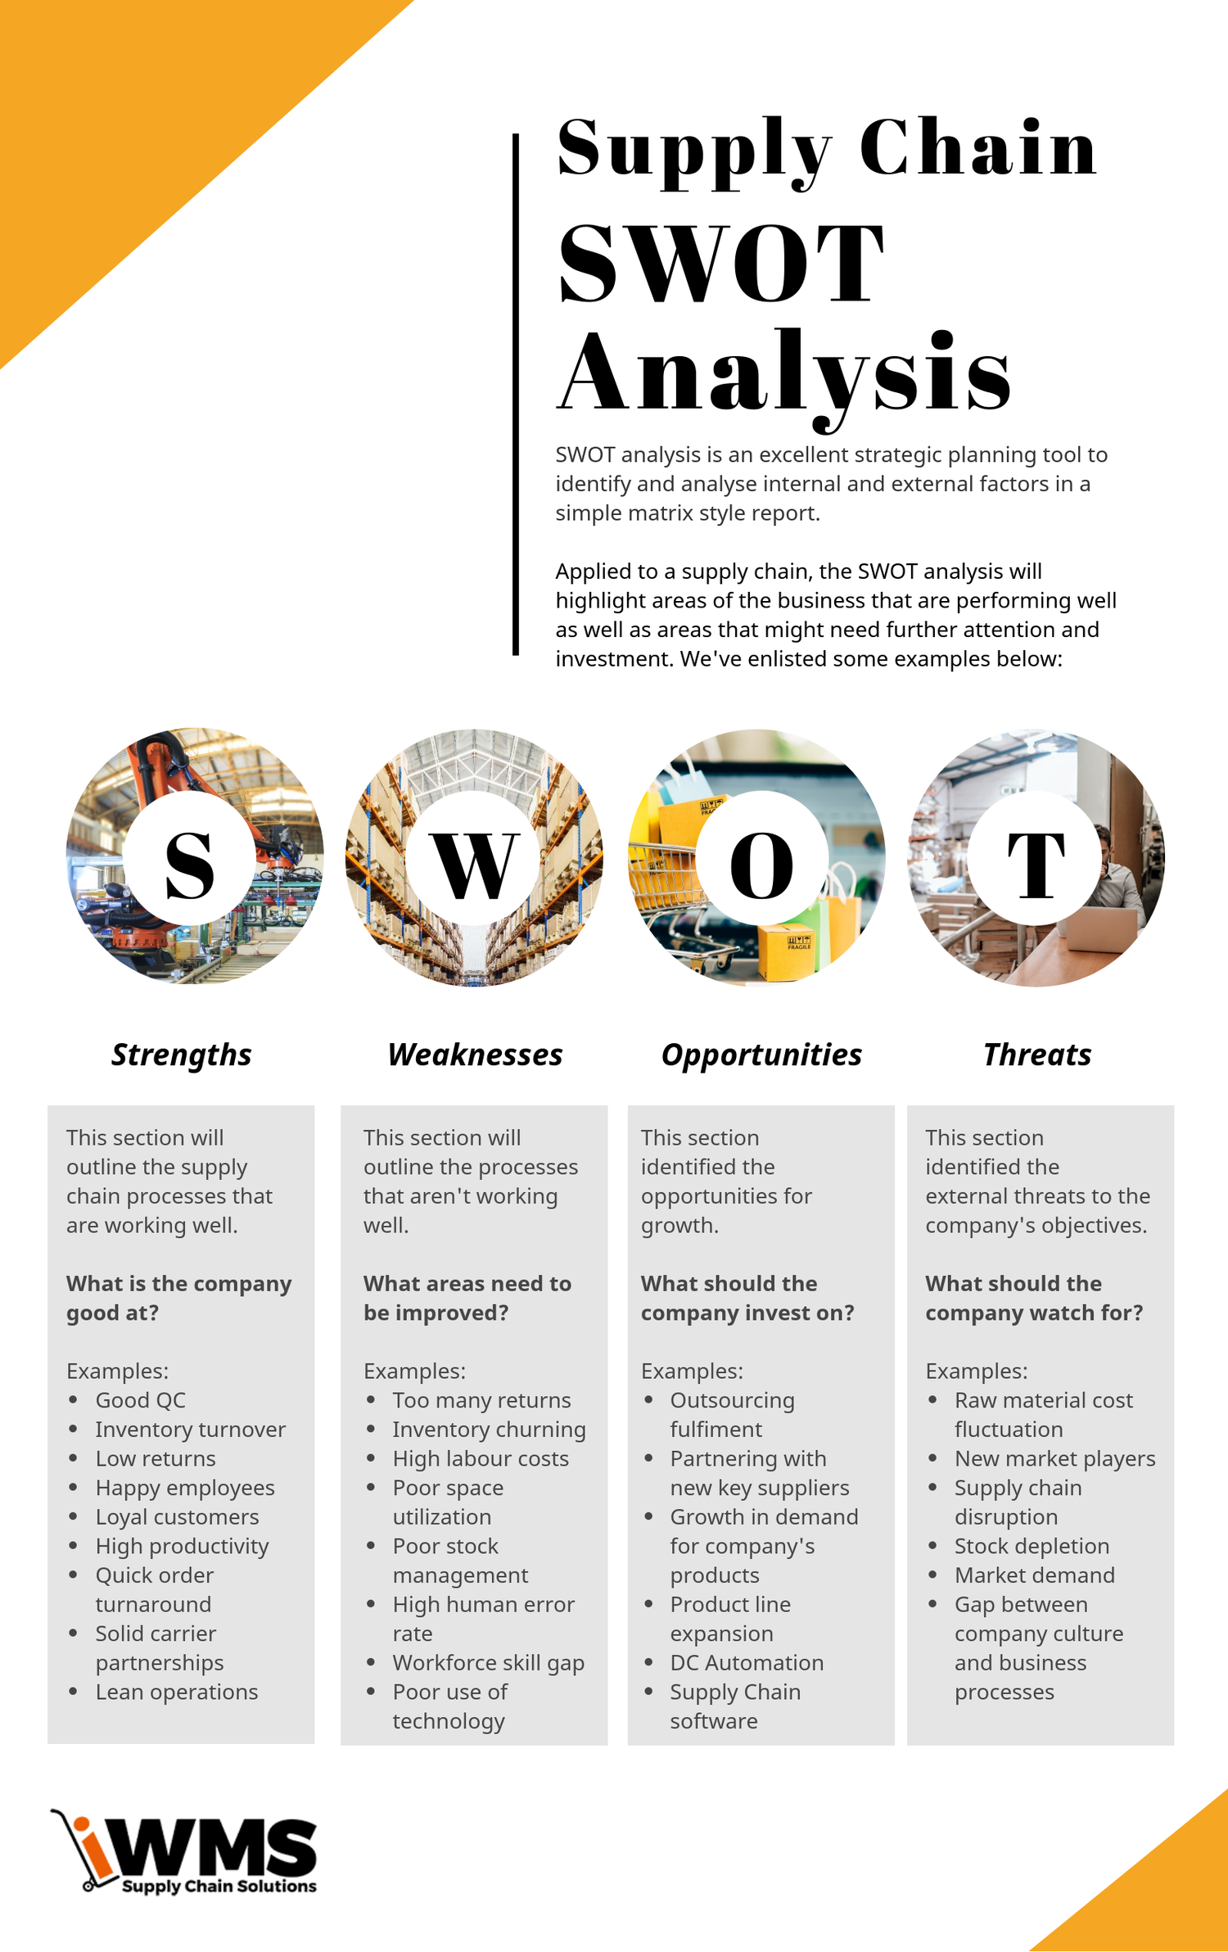
2.3 SWOT Analysis
Present GreenCycle Mobility SWOT Analysis/Matrix
  Discuss their strengths and core competencies
  Discuss their weaknesses and supply chain issues
  Based on further Market Research, Industry trends, findings from PESTLE and Competitor Analysis research (only research, NO documentation)
  Discuss potential opportunities
  Discuss potential threats

Slide 21
Case Study: Rad Power Bikes – Assembly & Logistics Postponement in E-Bikes
1. Industry Context
The e-bike market is characterised by:
  High demand uncertainty by region
  Rapid component innovation (batteries, motors, displays)
  Wide variation in regulatory and consumer preferences (EU vs US vs UK)
Therefore, holding fully configured finished e-bikes in large volumes creates obsolescence risk and high inventory carrying cost.

Slide 22
2. Postponement Strategy Employed
Rad Power Bikes applies assembly postponement and logistics postponement:
  Core bike platforms (frames, wiring harnesses, wheels) are produced in standardised, generic form.
  Motors, batteries, controllers, and accessories are held as separate modules.
Final configuration is completed at regional distribution/assembly centres close to the market.
In effect, differentiation is delayed until actual market demand is known.

Slide 23
3. Where Postponement Occurs (Decoupling Point)
Before:
Fully configured e-bikes at overseas factories
After (Postponement):
Generic base bikes + modular components → final assembly in regional hubs
This shifts the Customer Order Decoupling Point (CODP) downstream.

Slide 24
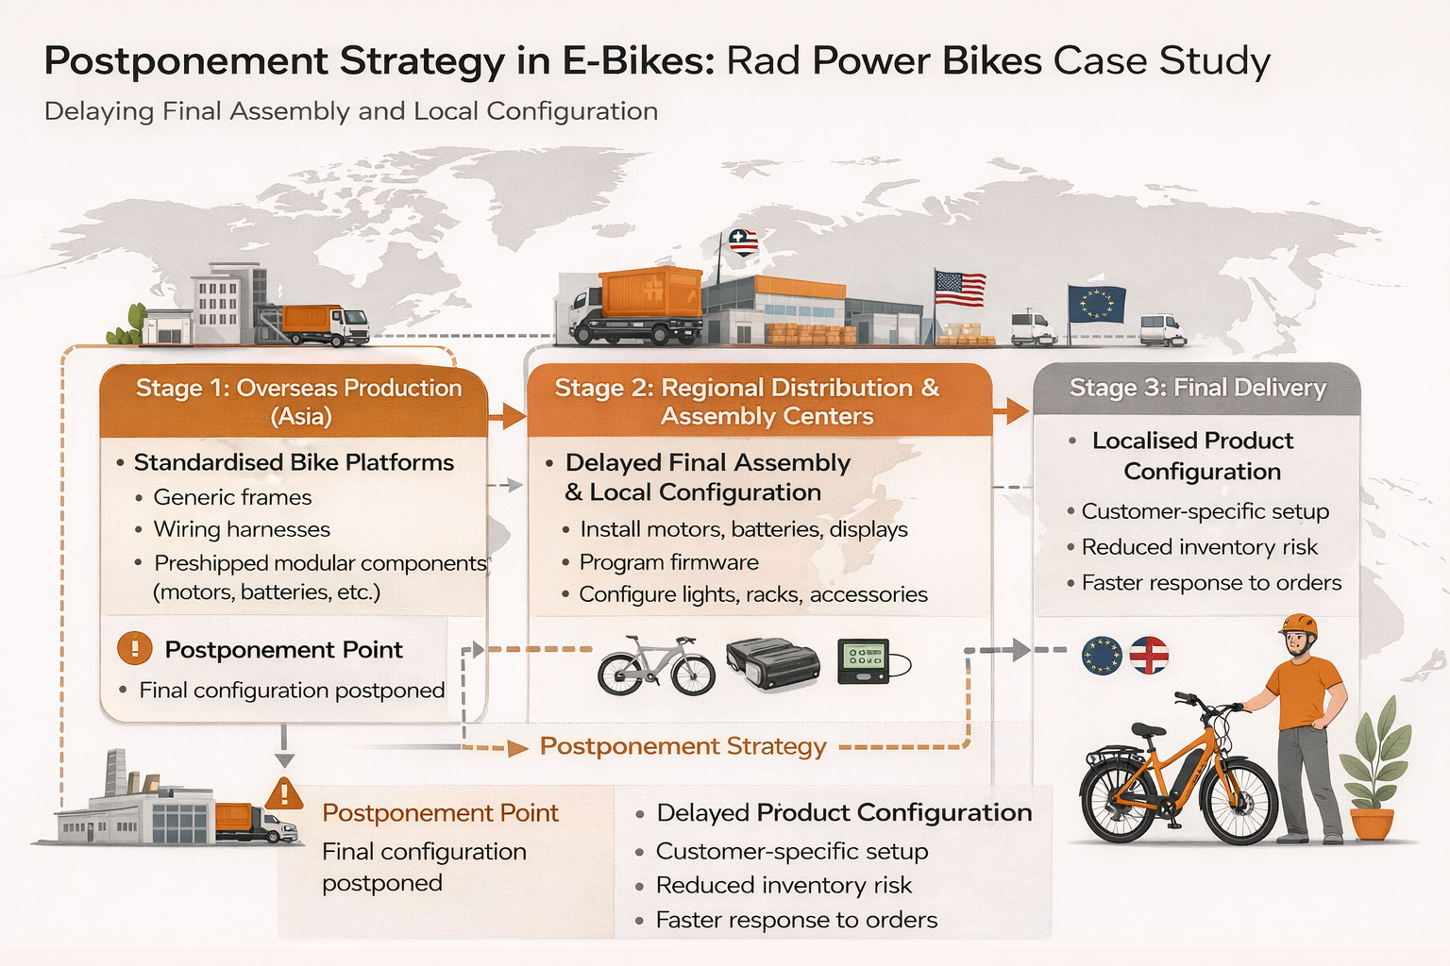

Slide 25
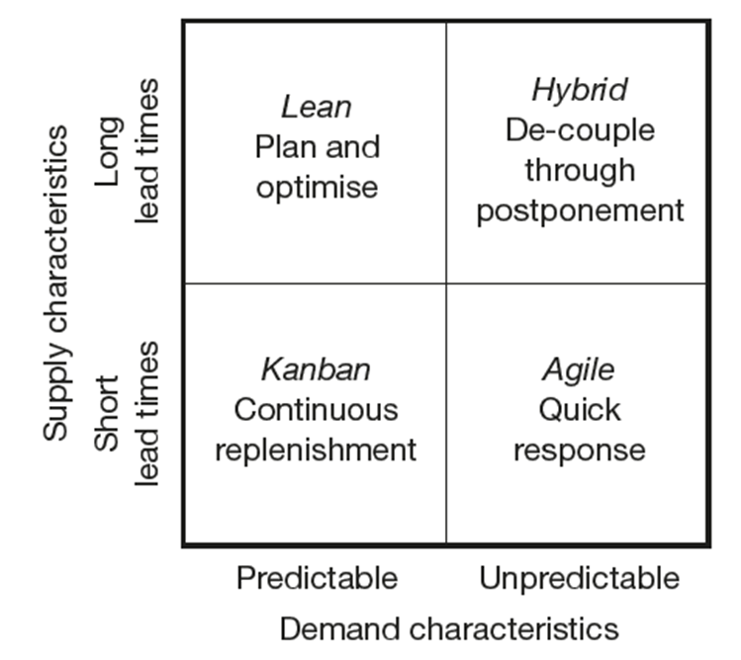
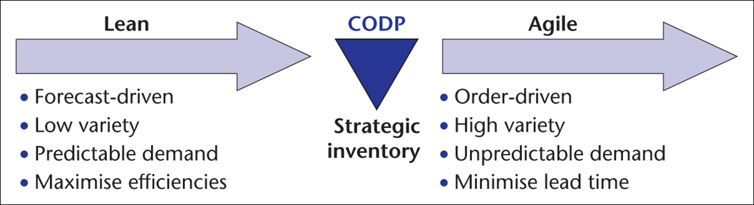
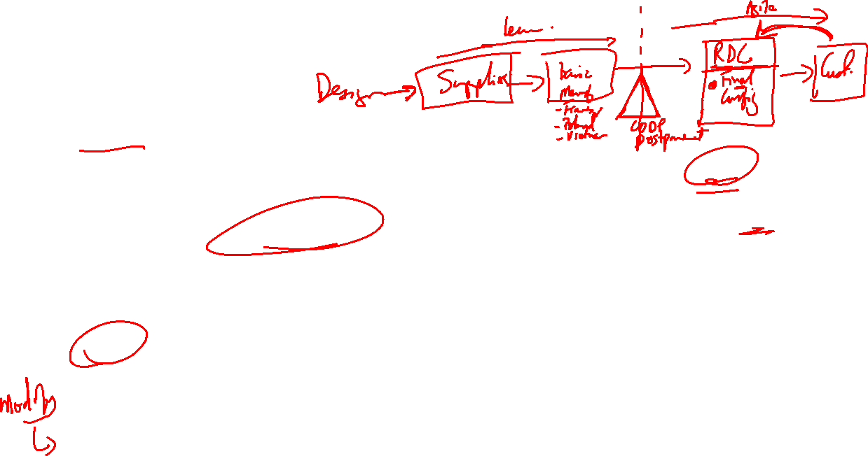
3.0 Supply Chain Strategy
Discuss the overall strategy that GreenCycle Mobility should use:
  Lean or Agile or Hybrid
    If Hybrid, identify the de-coupling point in the supply chain
    Discuss which type of Postponement will be used
  Use and review literature to support your recommendations, build argument, justify design, why?
  Draw the recommended Supply Chain Stages, showing what part is lean and agile.
Source: Christopher (2016)
Harrison et al (2008)

Slide 27
Recommend the establishment of a Centralised Regional Distribution Centres/ FACT hub for UK and EU market
  Where?- Gdansk, Birmingham ????
  New Partner should be 4PL/5PL:
    inventory handling- receive finished and semi-finished goods from Poland/Vietnam
    final configuration- Install batteries and electronics, Configure firmware, Add region-specific accessories and packaging
  Justify, outsourcing- strategic benefits to GreenCycle
  Orders fulfilled directly from RDC/FACT hub to customers
Discuss appropriate Logistics Strategy for:
  Moving Frame and Sub-Assemblies, components from factories and suppliers to RDC’s for final assembly then shipped direct to customers or Partners (e.g. local councils)
  Using the most efficient multi-transport mode
    Asia to EU- which mode?
    Intra EU- which mode?
    5PL Partnerships to coordinate

Slide 28
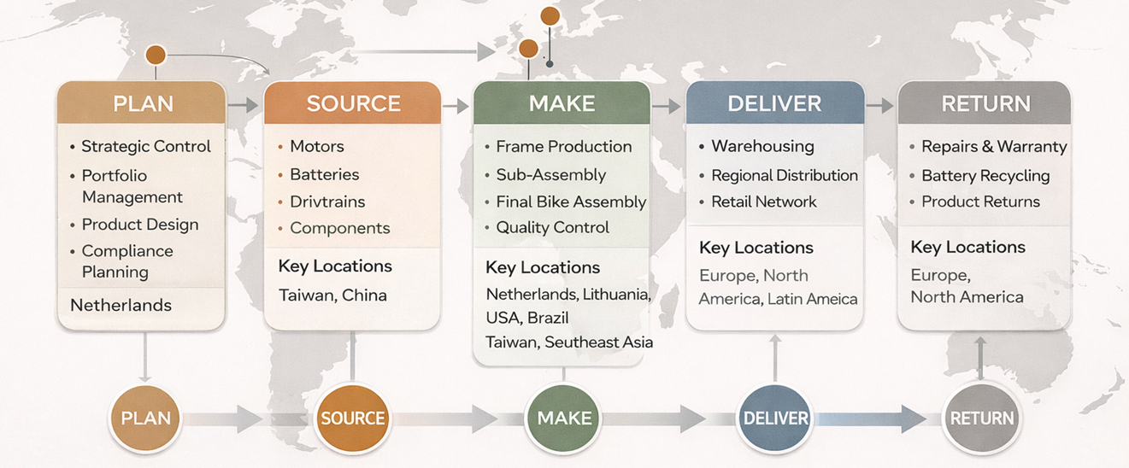
Now, given above recommendations;
Discuss GreenCycle Mobility’s location for Design, Suppliers, Production, RDCs, that make up their global supply chain.
Using the SCOR model, summarize and create visualize the Global SC

Slide 29
4.0 Implementing Future Technologies
Discuss need for creating an integrated SC and to facilitate SC Collaboration to share information
    Recommend a Digital Supply Chain
    Recommend Use of Industry 4.0 Technologies e.g. AI, Machine Learning, Big Data for Visibility, Market Sensing etc.
Explain the role of these technologies in promoting sustainable practices.
Recommend solutions i.e. specific systems- ERP, CRM, S&OP

Slide 30
5.0 Regulatory Impact
Explore the implications of eWaste regulations i.e. how regulations may affect their supply chain
Recommend the necessity for Greencycle Mobility to develop reverse logistics systems.
  Discuss the concept of Reverse Logistics and creating a Closed loop
  Discuss how Returns from clients will be handled e.g. collections at retail partner stores
  Debate and recommend whether to outsource to 3PL or handle reverse logistics in-house
  Use of recycle materials for packaging

Slide 31
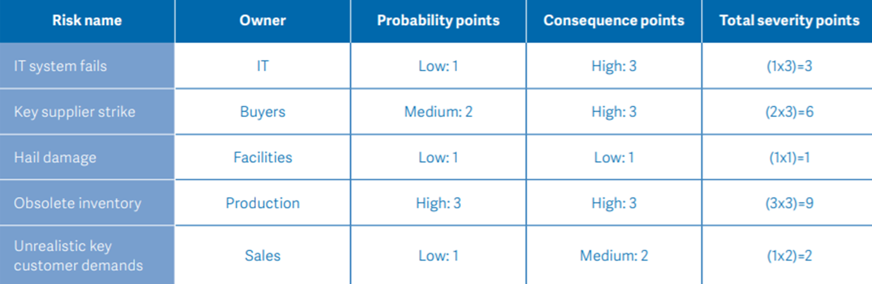
6.0 Supply Chain Risk Management
  Identify and discuss possible risk GreenCycle will encounter by going Global
  Use Risk identified in the case plus others (max 7 risks)
  Assess these risks, build a table
  Discuss mitigation strategies
    Could add to table as a new column

Slide 32
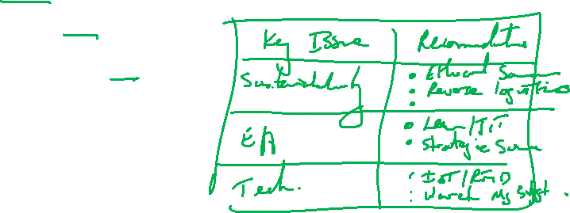
7.0 Conclusion
Provide a summary of key findings from Scenario Analysis
Give a summary of key recommendations made for:
  Sustainability
  Operational Efficiency
  Technological Investments

Slide 33
Reference List
List all sources used, including academic references, industry reports, and case studies.
Follow the specified Anglia Ruskin Harvard Referencing style

